Slide 1

Android Development
Chapter 1 – Getting Started with Android Programming

Slide 2

Beginning Android 4 Application Development
Amazon.co.uk
http://www.amazon.co.uk/Beginning-Android-4-Application-Development/dp/1118199545/ref=pd_sim_b_2?ie=UTF8&refRID=0HCW1DQQPYNSVQ3A53D8
Bol.com
http://www.bol.com/nl/p/beginning-android-4-application-development/1001004011690816/

Slide 3
Android Development Chapter 1 – Getting Started with Android Programming
Android and its history

Slide 4
Android – The Mobile Operating System
Android is a mobile operating system
Based on the Linux kernel (version 2.6)
Originally developed by a startup company called Android inc.
Bought by Google in 2005
Released under the open source Apache License
Manufacturer’s such as Motorola and Sony Ericsson saw Android as a replacement for their own mobile OS’s
Main advantage is that Android offers a unified approach to application development
Developers only need to develop for Android and their app should run on numerous Android devices

Slide 5
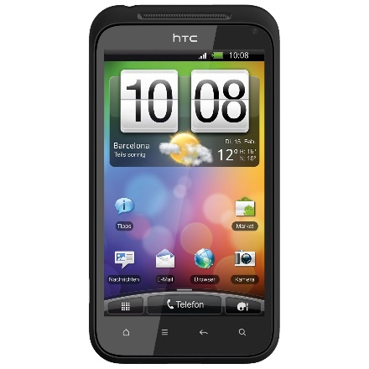
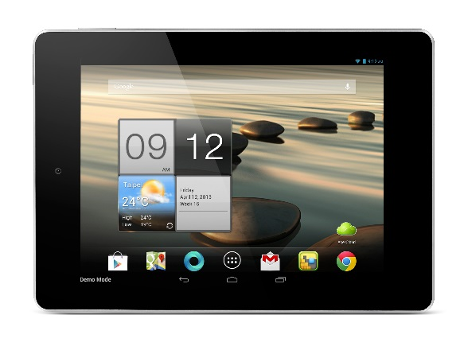
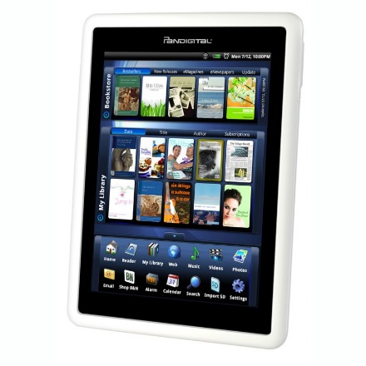
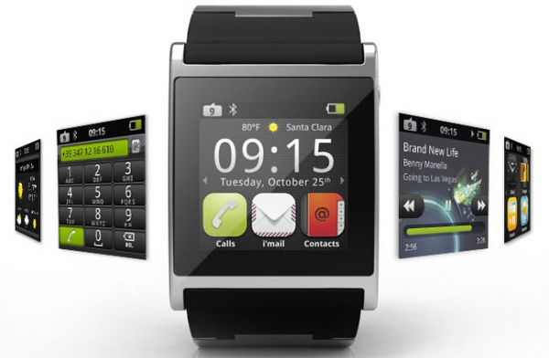
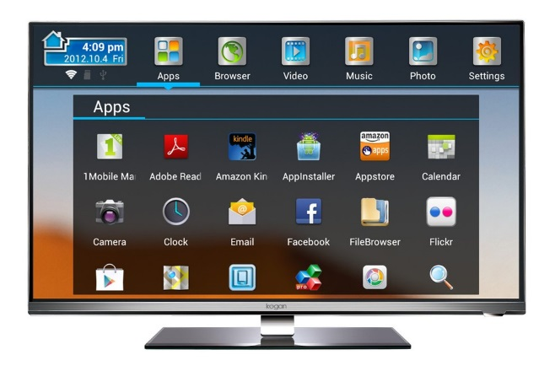
Android Devices
Smartphones
Tablets
e-book readers
Watches
TVs

Slide 6
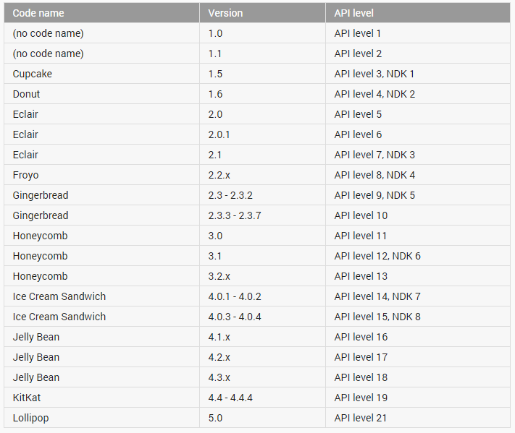
Android Versions

Slide 7
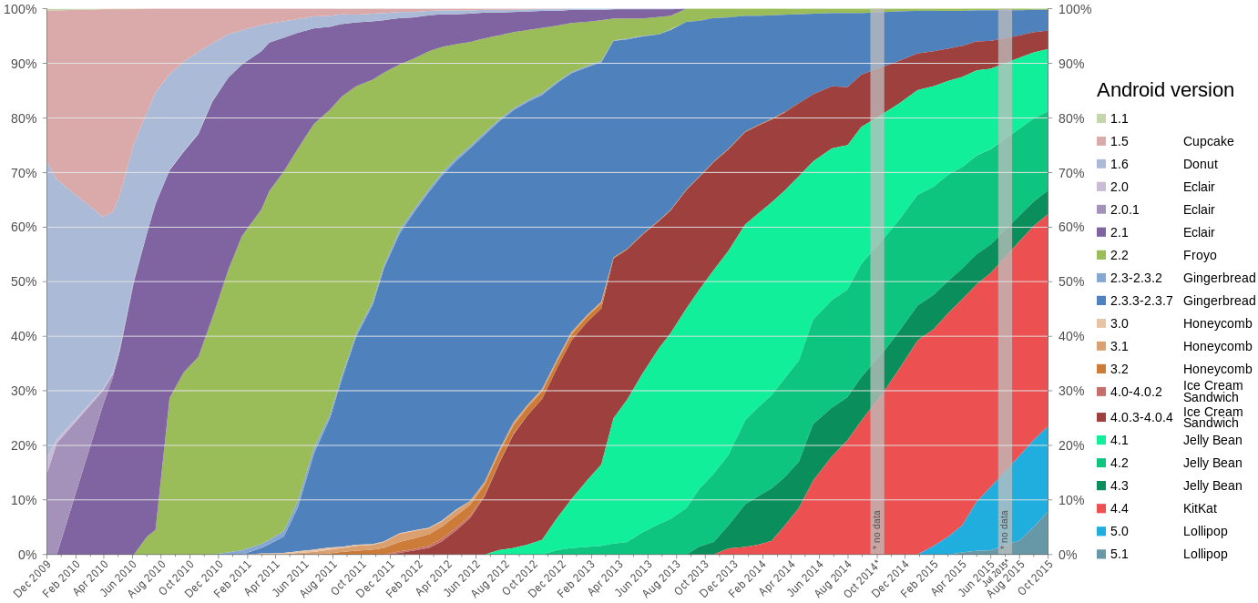
Android Versions

Slide 8
Android Versions - Milestones
Android 1.6, Donut
The world's information is at your fingertips – search the web, get driving directions ... or just watch cat videos.
Android 2.0, Eclair
Make your home screen just how you want it. Arrange apps and widgets across multiple screens and in folders. Stunning live wallpapers respond to your touch.
Android 2.2, Froyo
Voice Typing lets you input text, and Voice Actions let you control your phone, just by speaking.
Android 2.3, Gingerbread
New sensors make Android great for gaming - so you can touch, tap, tilt, and play away.

Slide 9
Android Versions - Milestones
Android 3.0, Honeycomb
Optimized for tablets
New UI, refined multitasking, tabbed browsing, auto fill form, bookmark synchronization, private browsing, ...
New features are not supported on smartphones
Android 4.0, Ice Cream Sandwich
Android comes of age with a new, refined design. Simple, beautiful and beyond smart.
All 3.0 features are supported on smartphones as well

Slide 10
Android Versions - Milestones
Android 4.1, Jelly Bean
Android is fast and smooth with buttery graphics. With Google Now, you get just the right information at the right time.
With more than 1 million apps on Google Play, and thousands of Android devices, you've got the freedom to do what you want on any device you choose.
Android 4.4, KitKat
Smart, simple, and truly yours. A more polished design, improved performance, and new features.
New features introduced such as facial recognition unlock, data usage monitoring and control, Near Field Communication (NFC)

Slide 11
Android Versions - Milestones
Android 5.0, Lollipop
A sweet new take on Android. Get the smarts of Android on screens big and small – with the right information at the right moment.
Notification control, better battery management, security, device sharing, support for TVs, ...
Released November the 3th (2014)
Android 5.1, Lollipop
Ability to join Wi-Fi networks and control paired Bluetooth devices from quick settings
Official support for multiple SIM cards
Device protection: if a device is lost or stolen it will remain locked until the owner signs into their Google account, even if the device is reset to factory settings.
High-definition voice calls, available between compatible devices running Android 5.1

Slide 12
Android Versions - Milestones
Android 6.0, Marshmallow
Unveiled under the codename "Android M" during Google I/O on May 28, 2015
For the Nexus 5 and Nexus 6 phones, Nexus 9 tablet, and Nexus Player set-top box
Native fingerprint reader support
Direct Share feature for target-specific sharing between apps
Do Not Disturb mode
Post-install/run-time permission requests
USB Type-C support
Automatic full data backup and restore for apps
4K Display mode for apps
Adoptable External storage to behave like Internal Storage
MIDI support for musical instruments
Experimental Multi Window feature

Slide 13
Android Features
Because Android is open source and freely available to manufacturers for customization, there are no fixed hardware or software configurations. However, Android itself supports the following features:
Storage - Uses SQLite, a lightweight relational database, for data storage.
Connectivity - Supports GSM/EDGE, IDEN, CDMA, EV-DO, UMTS, Bluetooth (includes A2DP and AVRCP), Wi-Fi, LTE, and WiMAX.
Messaging - Supports both SMS and MMS.
Web browser - Based on the open source WebKit, together with Chrome’s V8 JavaScript engine
Media support - Includes support for the following media: H.263, H.264 (in 3GP or MP4 container), MPEG-4 SP, AMR, AMR-WB (in 3GP container), AAC, HE-AAC (in MP4 or 3GP container), MP3, MIDI, Ogg Vorbis, WAV, JPEG, PNG, GIF, and BMP
Hardware support - Accelerometer Sensor, Camera, Digital Compass, Proximity Sensor, and GPS
Multi-touch - Supports multi-touch screens
Multi-tasking - Supports multi-tasking applications
Flash support - Android 2.3 supports Flash 10.1.
Tethering - Supports sharing of Internet connections as a wired/wireless hotspot

Slide 14
Android Development Chapter 1 – Getting Started with Android Programming
Android Architecture

Slide 15
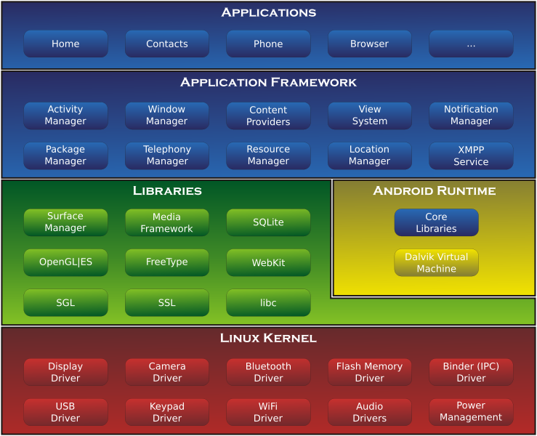
Android Architecture

Slide 16
Linux Kernel
Android is build on top of the Linux 2.6 kernel
Linux core functionality
Memory management
Process management
Networking
Security settings
Low-level device drivers for various hardware components of an Android device

Slide 17
Libraries
Contain all the code that provides the main features of an Android OS.
Examples:
SQLite library provides database support so that applications can use it for data storage
WebKit library provides functionalities for web browsing
Libc: c standard lib.
SSL: Secure Socket Layer
SGL: 2D image engine
OpenGL|ES: 3D image engine
Media Framework: media codecs
FreeType: Bitmap and Vector
SurfaceManager: Compose window manager with off-screen buffering

Slide 18
Android Runtime
Core Libraries
Provides the functionality of the JAVA Programming Language
Dalvik VM
A type of Java Virtual Machine
Register based (not stack machine like JVM)
Optimization for low memory requirements
Executes .dex (Dalvik-Executable) files instead of .class
Android application (APK) files contain executable bytecode files in the form of Dalvik Executable (DEX) files, which contain the compiled code used to run your app.
DX tool converts classes to .dex format
Each Android application:
runs on its own Process
runs on its own Instance of Dalvik VM
is assigned its own Linux user ID

Slide 19
Android Runtime
As of Android 5.0 (Lollipop) Google made internal changes to the platform, with the Android Runtime (ART) officially replacing Dalvik
Improved application performance
Changes intended to improve and optimize battery usage, known internally as Project Volta.
Dalvik
Android apps are deployed in Dalvik bytecode, which is portable, unlike native code.
To run the app on a device, the code has to be compiled to machine code.
Dalvik is based on JIT (just in time) compilation.
Each time you run an app, the part of the code required for its execution is going to be translated (compiled) to machine code at that moment.
As you progress through the app, additional code is going to be compiled and cached, so that the system can reuse the code while the app is running.
Pro: Smaller memory footprint and uses less physical space

Slide 20
Android Runtime
ART (Android RunTime)
Compiles the intermediate language, Dalvik bytecode, into a system-dependent binary.
The whole code of the app will be pre-compiled during install (once), thus removing the lag that we see when we open an app on our device.
With no need for JIT compilation, the code should execute much faster.
Except for the potential speed increase, the use of ART can provide an important secondary benefit.
As ART runs app machine code directly (native execution), it doesn't hit the CPU as hard as just-in-time code compiling on Dalvik.
Less CPU usage results in less battery drain, which is a big plus for portable devices in general.

Slide 21
Application Framework
Exposes the various capabilities of the Android OS to application developers so they can be used in their apps
Important blocks:
Activity Manager: Manages the activity life cycle of applications
Content Providers: Manage the data sharing between applications
Telephony Manager: Manages all voice calls. We use telephony manager if we want to access voice calls in our application.
Location Manager: Location management, using GPS or cell tower
Resource Manager: Manage the various types of resources we use in our Application

Slide 22
Applications
This is where our applications are placed.
Some pre-installed applications:
SMS client app
Dialer
Web browser
Contact manager
...
As developers, we are able to write an app which replaces any existing system app.
No compulsory applications
Equality among apps
Easily embedded web browser
Parallel running

Slide 23
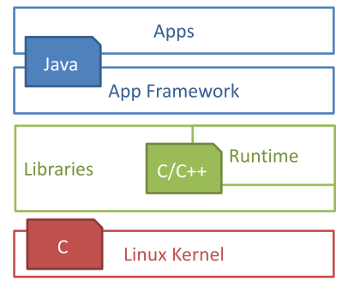
Used languages
Design goals
Open Source
High flexibility
High data accessibility
Rapid development (XML, Java)
Used Languages
App: Java
Framework: Java
Libraries: C/C++
OS & Drivers: C

Slide 24
Android Development Chapter 1 – Getting Started with Android Programming
Developing for Android

Slide 25
Android Studio
Android Studio is an integrated development environment (IDE) for developing for the Android platform.
Freely available under the Apache License 2.0.
First stable build was released in December 2014
Android Studio is designed specifically for Android development.
It is available for download on Windows, Mac OS X and Linux
Replaces Eclipse Android Development Tools (ADT) as Google's primary IDE for native Android application development.

Slide 26
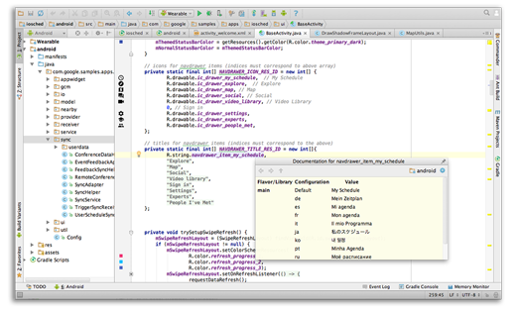
Android Studio
Intelligent code editor
At the core of Android Studio is an intelligent code editor capable of advanced code completion, refactoring, and code analysis.

Slide 27
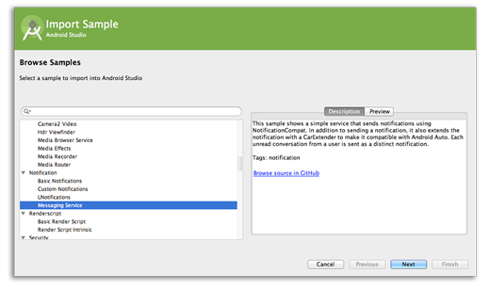
Android Studio
Code templates and GitHub integration
New project wizards make it easier than ever to start a new project.
Start projects using template code for patterns such as navigation drawer and view pagers, and even import Google code samples from GitHub.

Slide 28
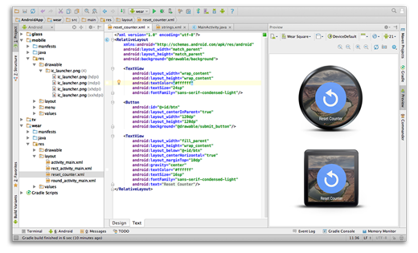
Android Studio
Multi-screen app development
Build apps for Android phones, tablets, Android Wear, Android TV, Android Auto and Google Glass.
With the new Android Project View and module support in Android Studio, it's easier to manage app projects and resources.

Slide 29
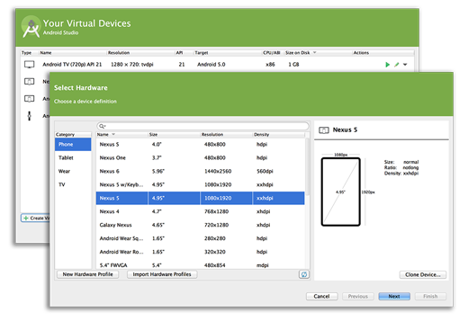
Android Studio
Virtual devices for all shapes and sizes
Android Studio comes pre-configured with an optimized emulator image.
The updated and streamlined Virtual Device Manager provides pre-defined device profiles for common Android devices.

Slide 30
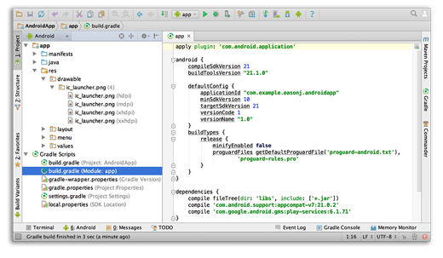
Android Studio
Android builds evolved, with Gradle
Create multiple APKs for your Android app with different features using the same project.
Manage app dependencies with Maven.
Build APKs from Android Studio or the command line.

Slide 31
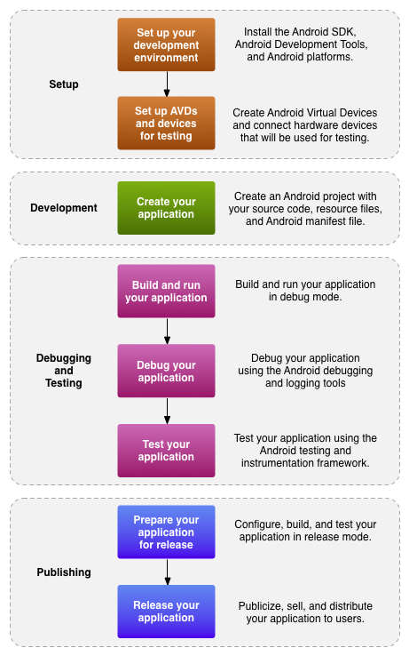
Development Workflow
We are going to do all of this
From this point on you're on your own

Slide 32
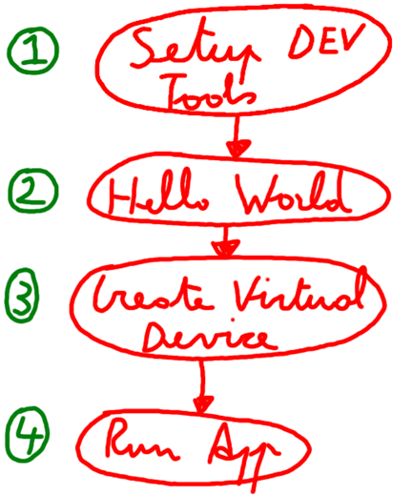
First Time Use Workflow

Slide 33
Android Development Chapter 1 – Getting Started with Android Programming
Step 1 - Setting Up Our Development Environment

Slide 34
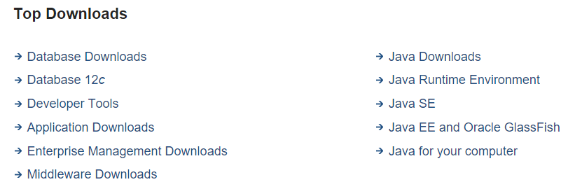
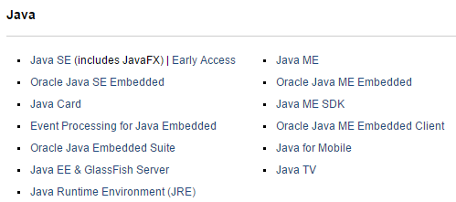
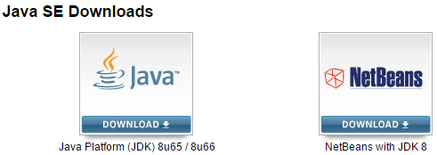
Step 1 - Setting Up Our Development Environment Installing Java SE
Start by installing the latest version of the Java Development Kit
Surf to https://www.oracle.com/downloads
Select "Java SE" from "Top Downloads"
Select "Java SE" from "Java" downloads
Choose the "JDK platform"

Slide 35
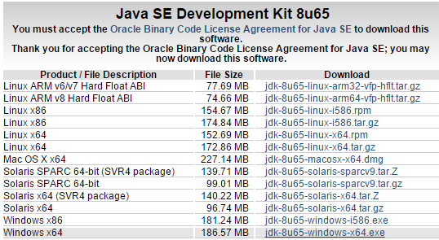
Step 1 - Setting Up Our Development Environment Installing Java SE
Download the latest stable release (x32 or x64) (don't forget to accept the license agreement)

Slide 36

Step 1 - Setting Up Our Development Environment Installing Java SE
Install the Java JDK before installing Android Studio.
Restart your computer (!MUST!)

Slide 37
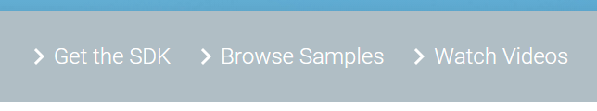
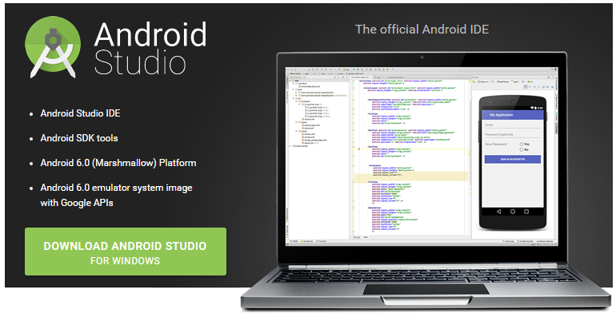
Step 1 - Setting Up Our Development Environment Installing Android Studio
To download Android Studio you need to surf to http://developer.android.com
Click the "Get the SDK"
Next choose "Download Android Studio"

Slide 38
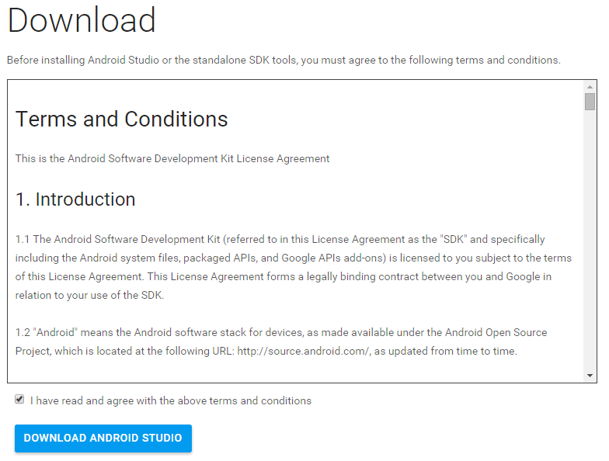
Step 1 - Setting Up Our Development Environment Installing Android Studio
Accept the license agreement and click "Download"

Slide 39
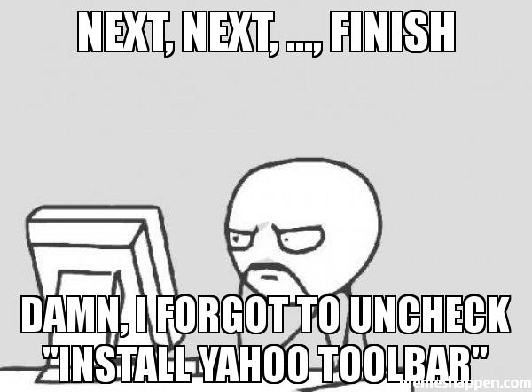
Step 1 - Setting Up Our Development Environment Installing Android Studio
Install Android Studio (Next -> Next -> .... -> Finish)

Slide 40
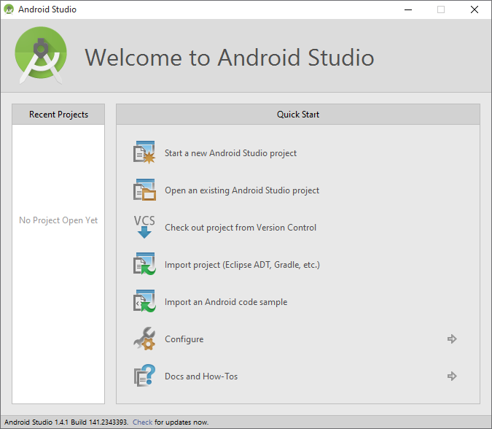
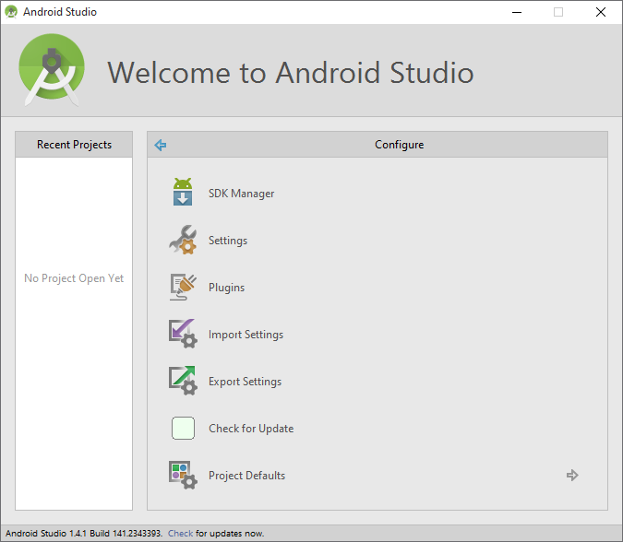
Step 1 - Setting Up Our Development Environment Installing Android Development Tools
Launch Android Studio
Choose "Configure"
Next pick "SDK Manager" to install Android SDK's

Slide 41
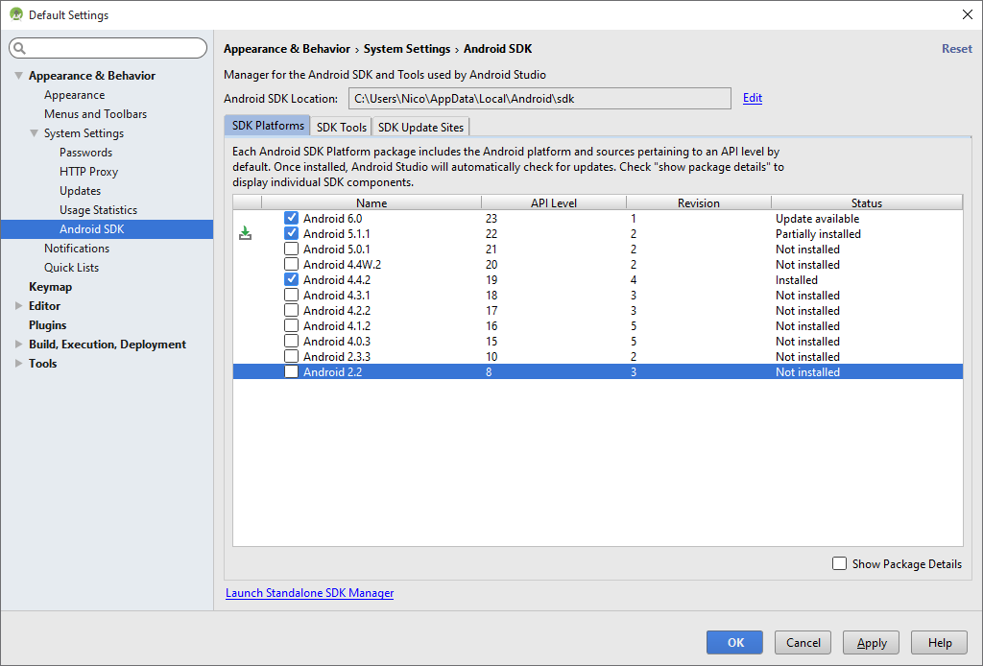
Step 1 - Setting Up Our Development Environment Installing Android Development Tools
Install Android 5.1.1 (API level 22)
Select "Android 5.1.1"
Hit "Apply"

Slide 42
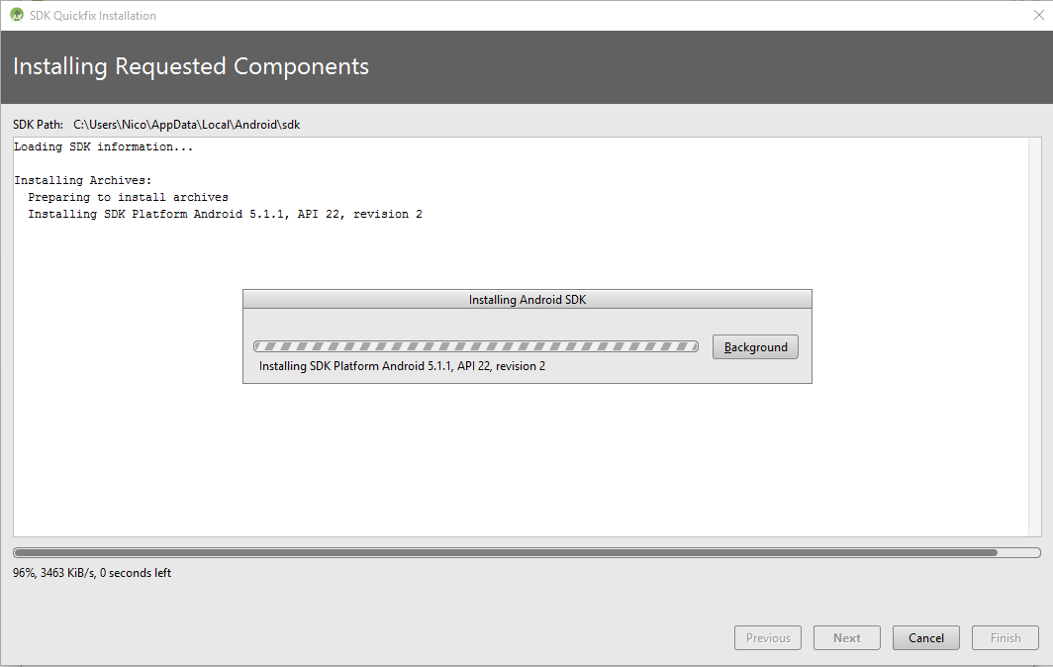
Step 1 - Setting Up Our Development Environment Installing Android Development Tools
Wait for the download and installer to finish

Slide 43
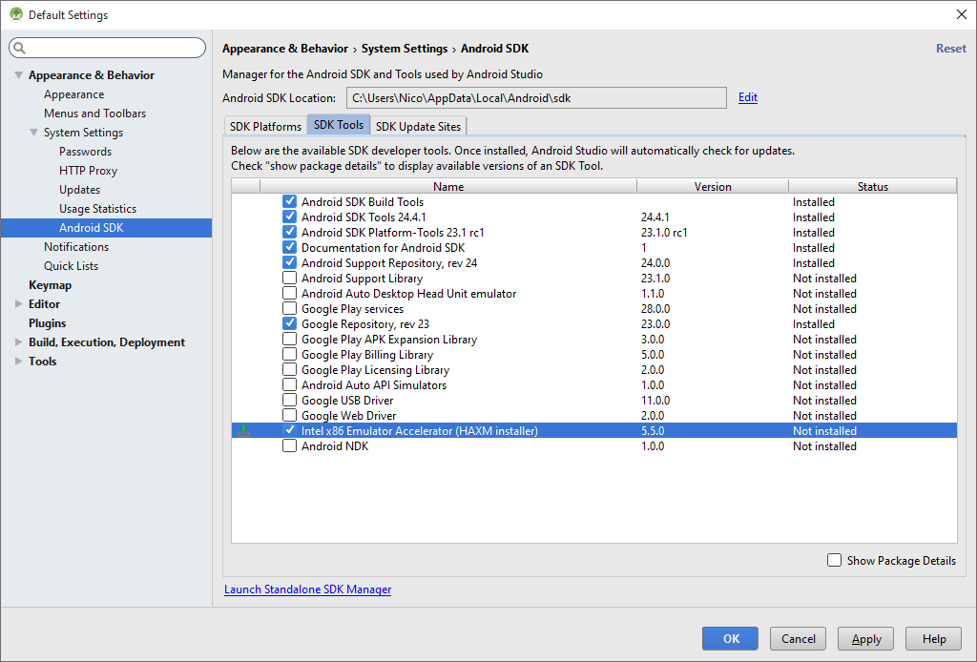
Step 1 - Setting Up Our Development Environment Installing Intel x86 Emulator Accelerator (HAXM Installer)
Install Emulator Accelerator
Select the SDK Tools Tab
Check "Installing Intel x86 Emulator Accelerator (HAXM Installer)"
Select "Apply"

Slide 44
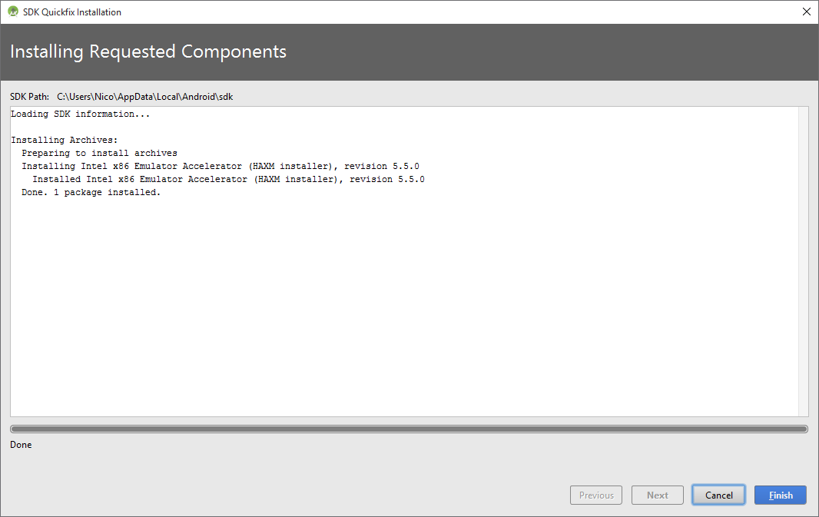
Step 1 - Setting Up Our Development Environment Installing Intel x86 Emulator Accelerator (HAXM Installer)
Wait for the download and installer to finish

Slide 45
Android Development Chapter 1 – Getting Started with Android Programming
Step 2 - Create a Hello World Application

Slide 46
Step 2 - Create a Hello World Application
Start Android Studio
Select "start a new Android Studio project"

Slide 47
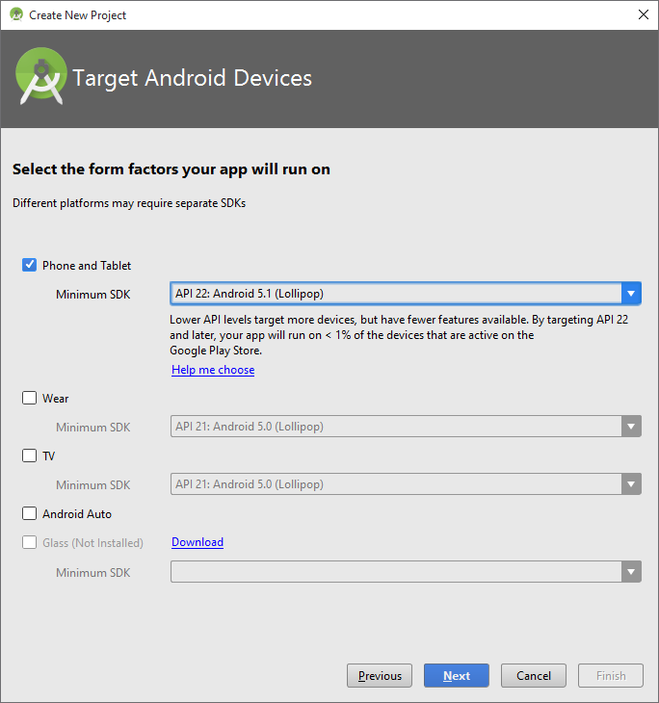
Step 2 - Create a Hello World Application
Select API 22 (Android 5.1)

Slide 48
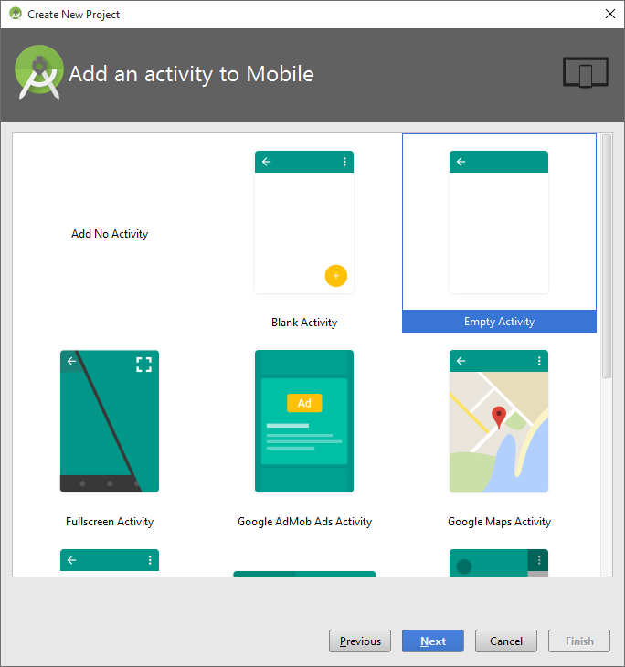
Step 2 - Create a Hello World Application
Next make sure to select the "Empty Activity" template
You can think of an activity as a graphical window shown to the user

Slide 49
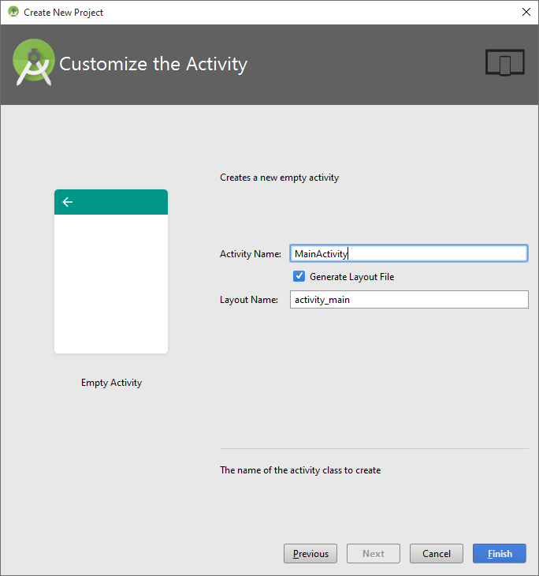
Step 2 - Create a Hello World Application
Give the activity a name
Leave the name for the main activity as is

Slide 50
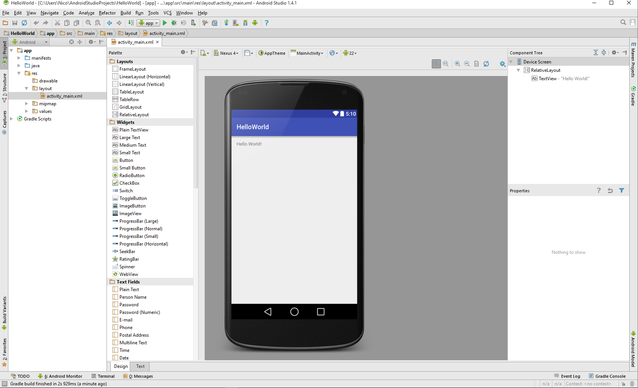
Step 2 - Create a Hello World Application
Your project should open now

Slide 51
Android Development Chapter 1 – Getting Started with Android Programming
Step 3 - Creating an Android Virtual Device

Slide 52
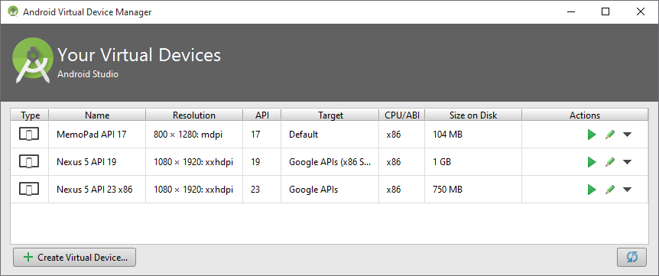
Step 3 - Creating an Android Virtual Device
Android applications may be run on a real device or on the Android Emulator, which ships with the Android SDK.
Let's create an Android Virtual Device (AVD)
Go to "Tools" => "Android" => "AVD Manager"
Click "Create Virtual Device …"

Slide 53
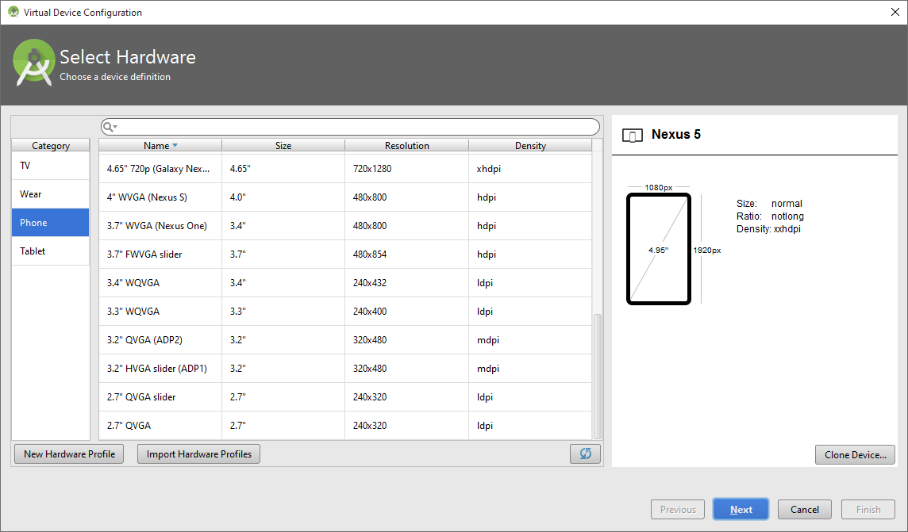
Step 3 - Creating an Android Virtual Device
Click "New Hardware Profile"

Slide 54
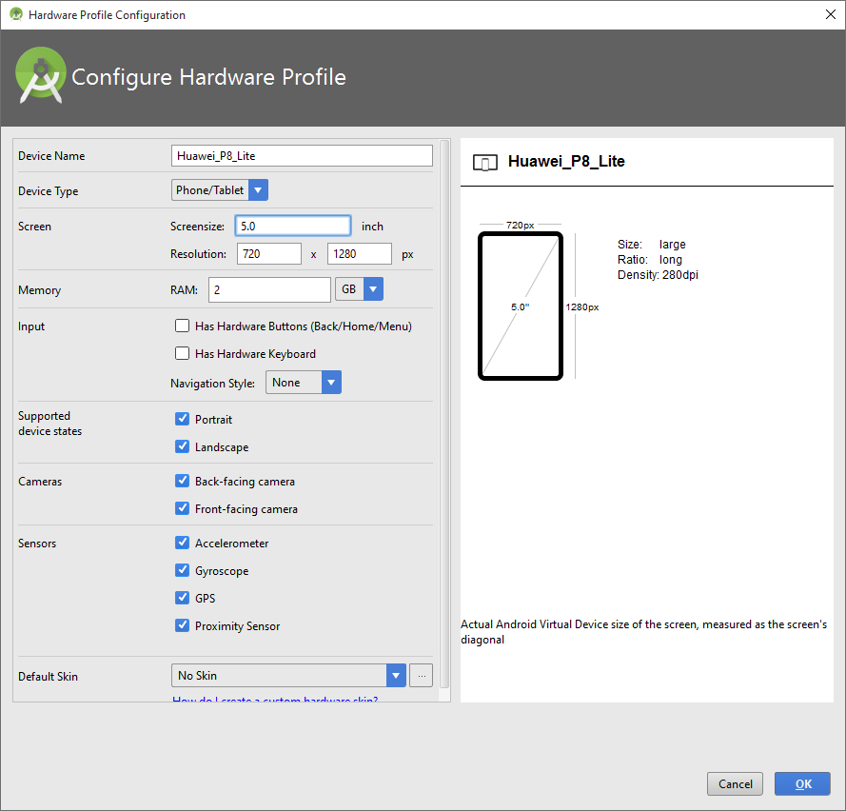
Step 3 - Creating an Android Virtual Device
Let's create a profile for the Huawei P8 Lite
Screensize = 5 inch
Resolution = 720 x 1280
RAM = 2GB
Click "OK"

Slide 55
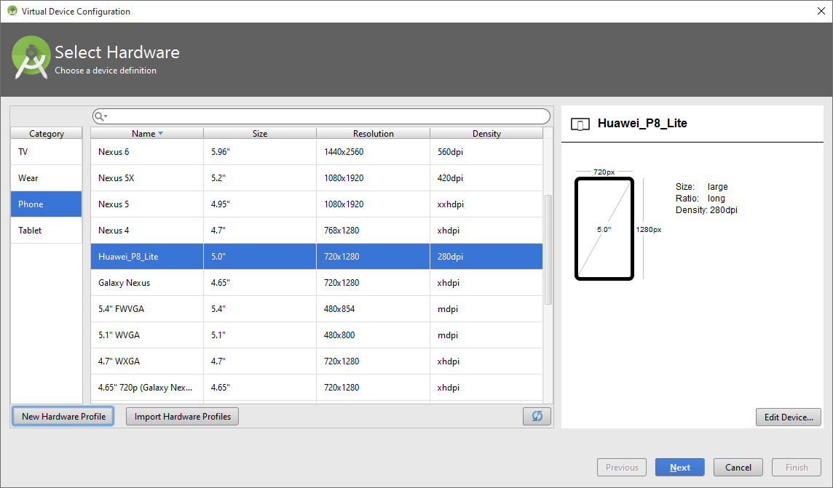
Step 3 - Creating an Android Virtual Device
Select your new hardware profile and click "Next"

Slide 56
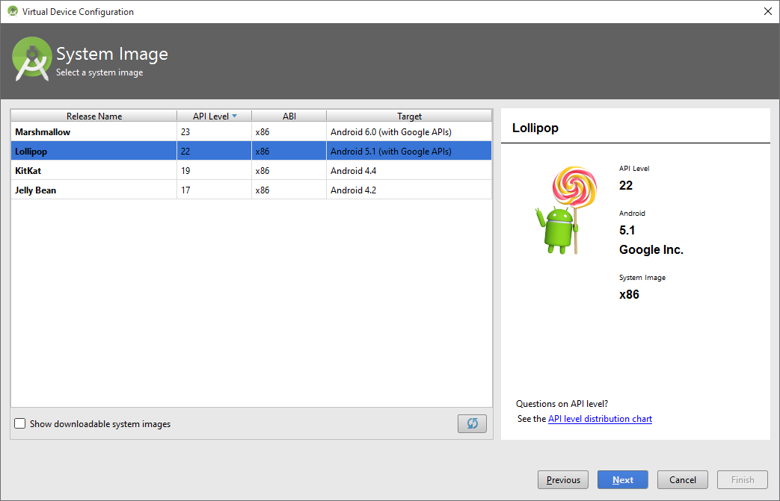
Step 3 - Creating an Android Virtual Device
Select the Android version you want to run on your AVD and hit "Next"
In our case Android 5.1 (API 22)

Slide 57
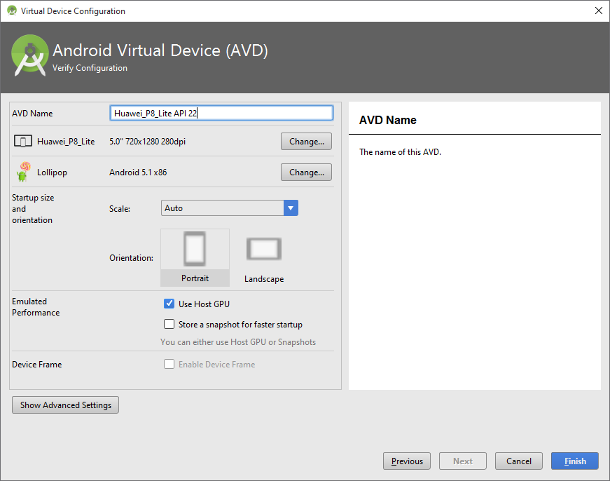
Step 3 - Creating an Android Virtual Device
Leave the default settings and hit "Finish"

Slide 58
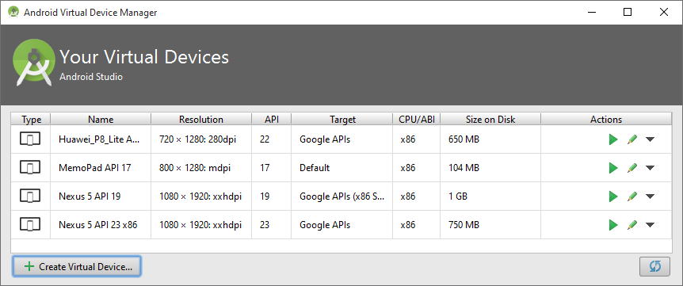
Step 3 - Creating an Android Virtual Device
Your new AVD should appear in the list
Close the AVD window

Slide 59
Android Development Chapter 1 – Getting Started with Android Programming
Step 4 - Run Your Application on the AVD

Slide 60
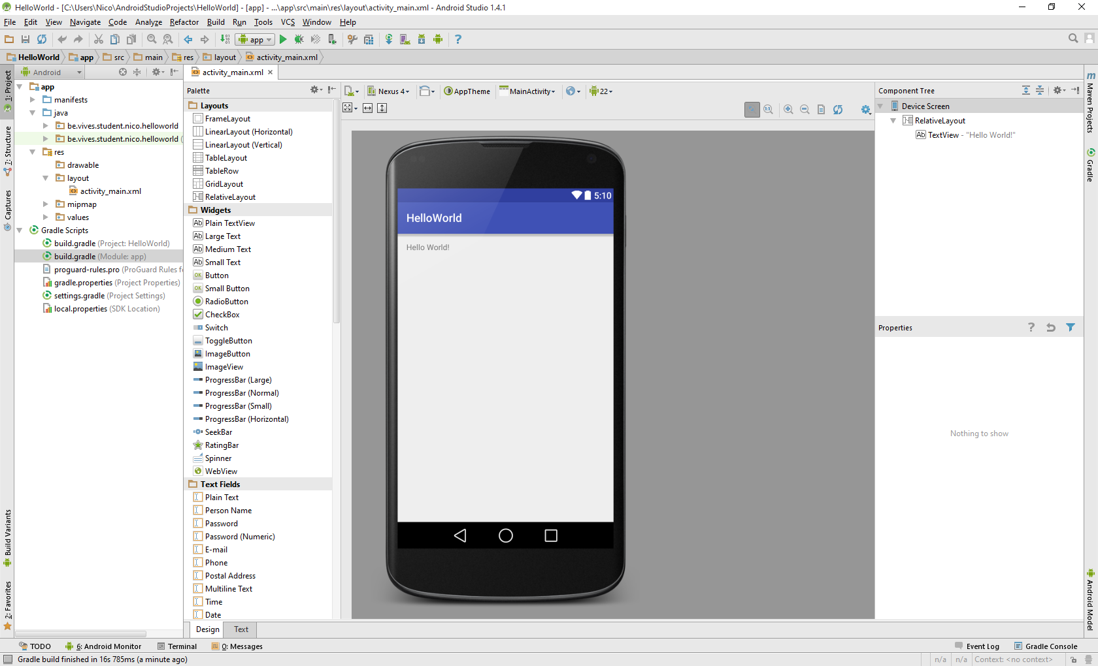
Step 4 - Run Your Application on the AVD
Click the green play button to run your application

Slide 61
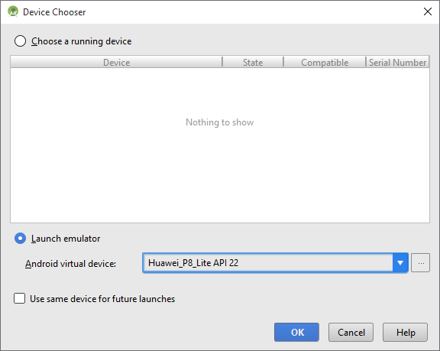
Step 4 - Run Your Application on the AVD
The "Device Chooser" should appear
Select your custom virtual device from the dropdown and click "OK"
Next time you can choose the AVD from the running devices if you don't close the AVD between tests

Slide 62
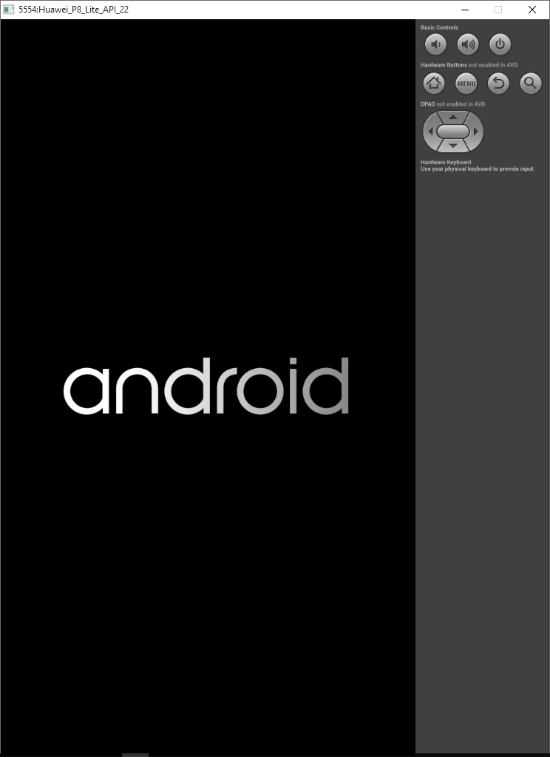
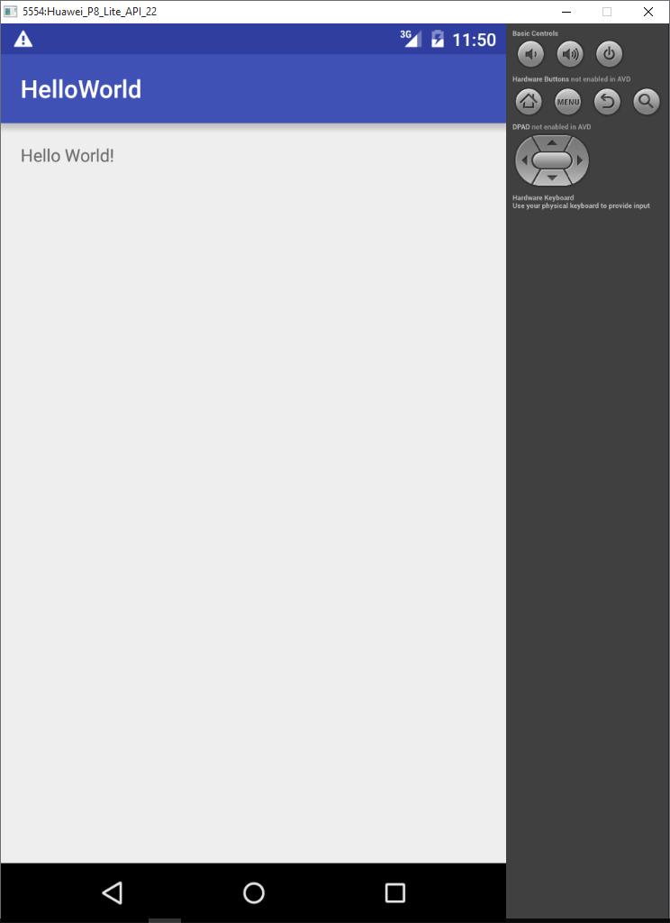
Step 4 - Run Your Application on the AVD
The AVD should start and your application should show
You may need to swipe up to see your app

Slide 63
Android Development Chapter 1 – Getting Started with Android Programming
Anatomy of an Android Application

Slide 64
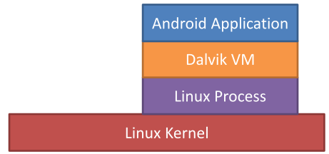
Application Fundamentals
Development Language
Java
Android SDK tools compile the code into an Android package, an archive file with an .apk suffix
Security sandbox
Each application has a unique Linux user ID
Each process has its own virtual machine (VM)
Every application runs in its own Linux process
Principle of least privilege
Each application, has access only to the components that it requires to do its work and no more.

Slide 65
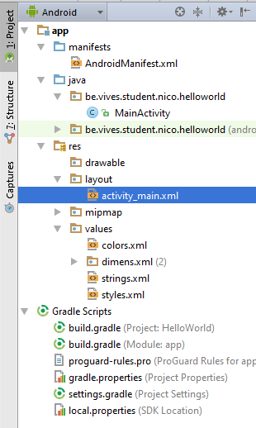
Anatomy of an Android Application
Show project pane by selecting "Project" on left side
Make sure to select the "Android" view
The Android project view in Android Studio shows a flattened version of your project's structure that provides quick access to the key source files of Android projects
Do note that the project structure on disk differs from this representation.

Slide 66
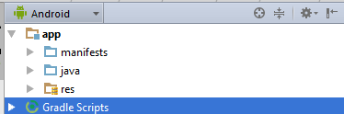
Anatomy of an Android Application
At the top level we find the following elements
manifests
Manifest files
Control files that describes the nature of the application and each of its components
java
Contains the java source code files
res
Contains all the resource files used in the application such as images (multiple resolutions), GUI layout and string literals

Slide 67
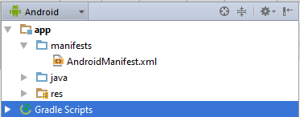
Anatomy of an Android Application Manifests
AndroidManifest.xml
This is the control file that describes the nature of the application and each of its components.
It describes
certain qualities about the activities, services, intent receivers, and content providers;
what permissions are requested;
what external libraries are needed;
what device features are required,
what API Levels are supported or required;
The entry point of the application, defined inside an intent-filter. This defines how to application can be started and what the entry point is.
Cfr.: http://developer.android.com/guide/topics/manifest/manifest-intro.html

Slide 68
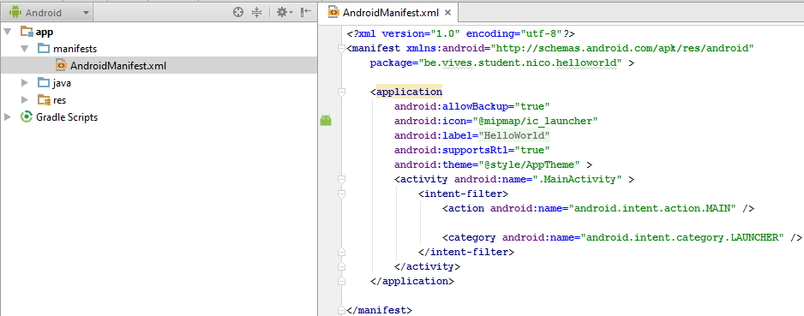
Anatomy of an Android Application AndroidManifests.xml

Slide 69

Anatomy of an Android Application Java Source Code Files
In the java element you find all the source code packages and their included source code files
In this app we find the "MainActivity.java" source code file
Note that in the Android project view the extension is not shown

Slide 70


Anatomy of an Android Application Resources
The res element contains all the resource files used in the application such as
images (multiple resolutions)
GUI layout
string literals (strings.xml; selection based on users locale)
In computing, a locale is a set of parameters that defines the user's language, country and any special variant preferences that the user wants to see in their user interface.
To see which locale are supported open a AVT and launch the application "Custom Locale"

Slide 71

Anatomy of an Android Application Resources
res/layout/*.xml
Defines the user interface for your activities.

Slide 72

Anatomy of an Android Application Resources
You can edit visual component properties by opening the "Component Tree" pane on the right
It will also show you a hierarchical view of the GUI components

Slide 73

Anatomy of an Android Application Resources
You can also directly edit the XML markup by selecting the "Text" view at the left bottom of the window

Slide 74
Android Development Chapter 1 – Getting Started with Android Programming
LAB Exercise

Slide 75
LAB Exercise
Change the text "Hello World" to "Hello Universe"
Add a label at the bottom stating "Developed by … @VIVES"
Add a button to your application and change the text to "Touch Me Please"
Give the button a decent ID
Example "touchMeButton"
This will allow you and others to easily identify the button

Slide 76
LAB Exercise
Add the following code to your "Main Activity" java source code file
This code will show a small message at the bottom (called a Toast in Android) when the button is clicked.
This is also called an event handler
Note the argument which is the View (graphical element) that caused the event handler to be fired
Always public and void (no return value)
You can use the ALT-ENTER shortcut key to import libraries when necessary
public void touchMePleaseOnClick(View view) { Toast.makeText(this, "Hello Universe", Toast.LENGTH_SHORT).show(); }

Slide 77
LAB Exercise
While we did create a method with code to be executed when the button is pressed there is no connection between the method and the actual button
This needs to be done in the markup code of the button (in the XML file)
We call this registering an event handler
Notice that we need to specify the name of the method for the "onClick" property (case sensitive !)
Tab completion will be your best friend if you allow it to be !!!!
<Button android:layout_width="wrap_content" android:layout_height="wrap_content" android:text="Touch Me Please" android:id="@+id/touchMeButton" android:layout_alignParentBottom="true" android:layout_centerHorizontal="true" android:onClick="touchMePleaseOnClick"/>

